Slide 1
An Investigation on Chinese Tone Learning Strategies 中文声调学习策略研究
——wú sīsī
吴思思

Slide 2
Tones in Mandarin

Slide 3
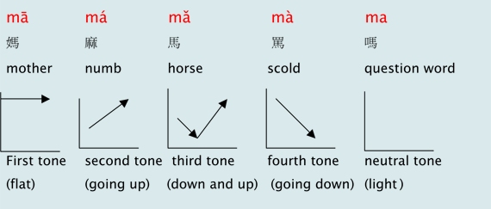
What are the tones in Chinese?
pitch patterns
carry lexical meanings
represented by diacritics
five

Slide 4
What is Learning Strategy?
The conscious or semi-conscious thoughts and behaviors used by learners to improve their target language (Cohen，2003）

Slide 5
Why this topic? 为什么研究声调？
前期的声调研究
（Miracle 1989， Shen 1989， McGinnis 1996， Chen 1997…）
学生的声调偏差模式
中英声调对比分析
三声变调
中文声调与语调
标新立异的教学方法
xiǎojiě, shuì jiào yī wǎn duō shǎo qián ?
xiǎojiě, shuǐ jiǎo yī wǎn duō shǎo qián ?
Lǎoshī, wǒ xiǎng wèn nǐ
Lǎoshī, Wǒ xiǎng wěn nǐ

Slide 6
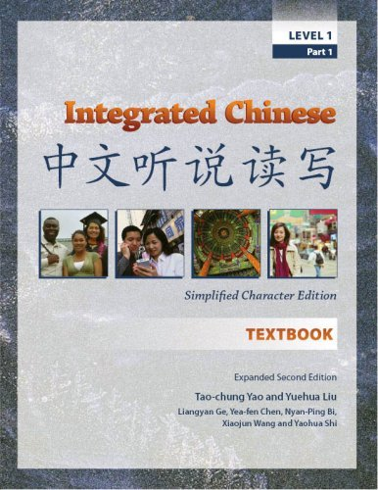
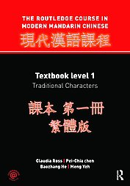
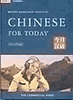
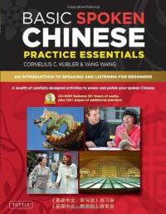
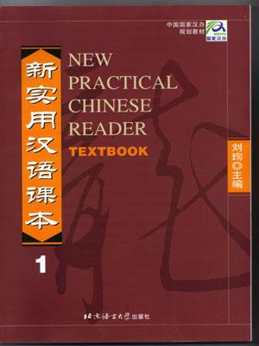
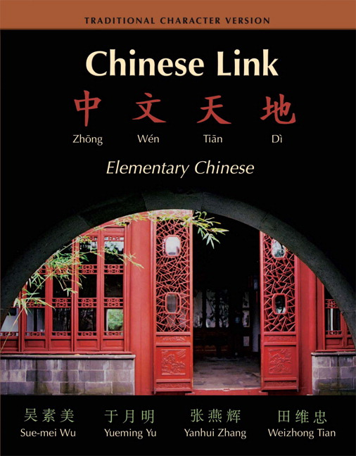
Research Procedure
Reviewing Literature
16 textbooks + 5 interviews
Learner Training materials

Slide 7
Literature Review
Cornelius C.K. (2010). An Introduction to Speaking and Listening for Beginners. Basic spoken Chinese. (p. 37). Singapore: Berkeley Books Pte.Ltd.
Cohen, A.D. (2003). The learner’s side of foreign language learning. International Review of Applied Linguisitics in Language Teaching. 41,4: p. 280-291.
Chen, G.T. (1974). Pitch Range of English and Chinese Speakers. Journal of Chinese Linguistics. 2: 159-171.
Dowsett, G. (1986). Interaction in the semi-structured interview. In M. Emery (Ed.), Qualitative research (p. 50-56). Canberra: Australian Association of Adult Education.
Miracle, W.C. (1989). Tone Production of American Students of Chinese. Applied Linguistics and Acquisition. 25:43-60.
O’Malley, J.M., and Chamot, A.U. (1990) Learning strategies in second language acquisition. Cambridge, New York: Cambridge University Press.
Ross, C. (2001). Evaluating intermediate Chinese textbooks. Journal of the Chinese Language Teachers Association 36:1-22.
Shen, Xiaonan Susan. (1989). Toward a register approach in teaching Mandarin tones.
Journal of the Chinese Language Teachers Association, 24, 27-47
Woo, W. (1976). A musical approach to tone teaching in Mandarin. Journal of the Chinese Language Teachers Association, 2:96-102.
Xing, Z.Q. (2010). Current situation of Teaching Chinese as a Foreign Language and its teaching methodologies. Taiwan Journal of Chinese as a Second Language. 1:1-18
Zev, B.L. (1991). Two Innovations for Teaching Tones. Journal of the Chinese Language Teachers Association, 3: 1-24.
Zhang, H.S. (2006). Mandarin can be taught in this way. (p.27). Beijing: Business Press.
Mirade, W.C. (1989). Tone Production of American Students of Chinese: A Preliminary Acoustic Study. Journal of the Chinese Language Teachers Association, 25(3), 49-66

Slide 8
List of textbooks
Cornelius C.K. (2010). An Introduction to Speaking and Listening for Beginners. Basic spoken Chinese. Singapore: Berkeley Books Pte.Ltd.
Ta-tuan C. & Perry L. & Yih-jian T. & Hai-tao T. (2007). Chinese Primer. New jersey: Princeton University Press.
Deng Y. & Xiong Y. & Yanjiao Z. & Wei-de Q. (1987). Elementary Chinese Course for Peking University Textbook. Beijing: Peking University Press.
Parker P. & Po-fei H. & Hugh M. S. (1976). Spoken Standard Chinese . Newyork: Far eastern Publications.
Defense Language Institute. (2004) Chinese Basic Program US: Defense Language Institute Foreign Language Center Publication
Jian-yi L. (2002). Chinese for Beginners. Beijing: Beijing Language & Culture University Press.
Minru L. (2004) Chinese: Communicating in the Culture. Ohio: Foreign Language Publications.
Xiao-hui Z. (2005). Chinese for Managers: Phonetics. Beijing: Foreign Language and Education Publications.
Tao-chung Y. Yuehua. L. (2005). Integrated Chinese. MA: Cheng & Tsui Company, Inc.
Zheng-zheng H. & Yongshou D. & Lanuyn L. (1986). Chinese for Today. Hongkong: The Commercial Press Ltd.
Xun L. (2004). New Practical Chinese Reader. Beijing: Beijing Language & Culture University Press.
Jiaying H. & Lanting X. (2009). Huanyin. MA: Cheng & Tsui Company, Inc.
Claudia R. & Baozhang H. & Pei-Chia C. & Yeh Y. (2010). The Routledge Course in Modern Mandarin Chinese. New York: Routledge.

Slide 9
Interviews
Interviewees
Two instructors
Three “good learners”
Semi-structured (25-30 mins)
Sample questions:
What do you think are the causes for the difficulties in learning tones?
What are some strategies or methods that you have been exposed to in or after class?
What are the strategies that you think very effective based on your own teaching/learning experience?

Slide 10
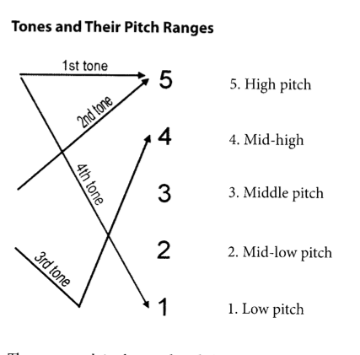
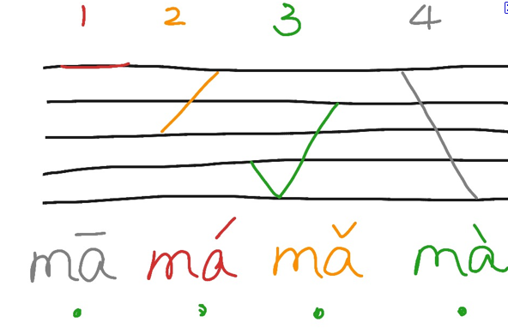
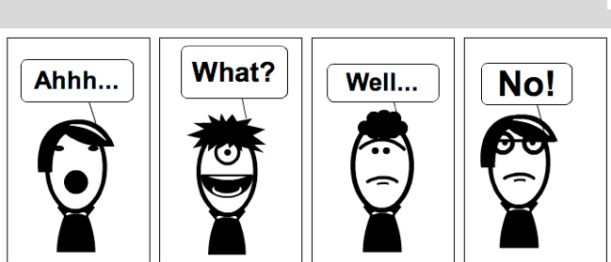
From the textbooks
Criteria for analyzing textbooks
Tone representations
Ways of introducing the concept of tones
Types of practices

Slide 11
From interviewing students
Music!!!!
Motivation (no correction at the beginning)
Talk to nativespeaks
one-on-one practice with teachers
Tongue Twister
From interviewing the teacher
Music!!!
Listen before speak
Ability to distinguish tones
Use intonations in English
Pitch range practice
Teach tone1,3 before tone2,4.
Effective feedback and error correction
Practice makes Perfect!

Slide 12
Learner Training
认识阶段
视觉／听觉／肢体等学习法
练习阶段
大声朗读
听力练习
复读
强化阶段
纠错
一对一练习
Meta-Cognitive 元认知
Cognitive 认知
Learning styles 学习风格
Affective 情感
＋

